Slide 1
Data structure and Algorithm Lesson 1: Introduction
DII Summer 2021
By Aj.Suttinee

Slide 2
Data structure and Algorithm

Slide 3
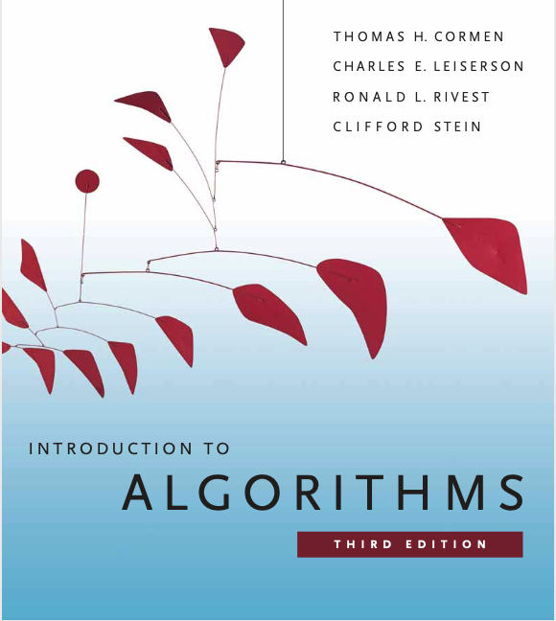
The definition of data structures
Data structure is a way to store and organize data in order to facilitate access and modifications.
No data structure is perfect.

Slide 4
Example 1: Digital Forum
Table checklist
Name card with next seat no.

Slide 5
Example 2: Mini Map

Slide 6
Linear and non-linear data structures
Key | Linear Data Structures | Non-linear Data Structures
Data Element Arrangement | In linear data structure, data elements are sequentially connected and each element is traversable through a single run. | In non-linear data structure, data elements are hierarchically connected and are present at various levels.
Levels | In linear data structure, all data elements are present at a single level. | In non-linear data structure, data elements are present at multiple levels.
Implementation complexity | Linear data structures are easier to implement. | Non-linear data structures are difficult to understand and implement as compared to linear data structures.
Traversal | Linear data structures can be traversed completely in a single run. | Non-linear data structures are not easy to traverse and needs multiple runs to be traversed completely.
Memory utilization | Linear data structures are not very memory friendly and are not utilizing memory efficiently. | Non-linear data structures uses memory very efficiently.
Time Complexity | Time complexity of linear data structure often increases with increase in size. | Time complexity of non-linear data structure often remain with increase in size.
Examples | Array, List, Queue, Stack. | Graph, Tree.
Ref: https://www.tutorialspoint.com/difference-between-linear-and-non-linear-data-structures https://www.geeksforgeeks.org/difference-between-linear-and-non-linear-data-structures/

Slide 7
The definition of algorithms
An algorithm is any well-defined computational procedure that takes some value, or set of values, as input and produces some value, or set of values, as output.
An algorithm is thus a sequence of computational steps that transform the input into the output.

Slide 8
The definition of algorithms
An algorithm is said to be correct if, for every input instance, it terminates with the correct output. An incorrect algorithm might not terminate or terminates with an unexpected output

Slide 9
Example: Mini Map - Algorithm
Find places you can go from HOME
From each of those places, find all paths
Keep track of the distance you’re traveled
Repeat this process until you get to CAMT
Compare the distance you’re traveled
Find the shortest path

Slide 10
Group Activity
Why do we need to learn this course ?
Since nowaday we have such a powerful hardware and other techniques, do we still need algorithms ?
Other techniques are referred to:
hardware with high clock rates, pipelining, and superscalar architectures
easy-to-use, intuitive graphical user interfaces (GUIs)
object-oriented systems
local-area and wide-area networking

Slide 11
Why do we need to learn this course ?
Computational time
Memory

Slide 12
Other techniques
hardware with high clock rates, pipelining, and superscalar architectures
easy-to-use, intuitive graphical user interfaces (GUIs)
object-oriented systems
local-area and wide-area networking
Algorithms are at the core of most technologies used in contemporary computers

Slide 13
You may someday encounter a problem for which you cannot readily find a published algorithm. This course will teach you techniques of algorithm design and analysis so that you can develop algorithms on your own, show that they give the correct answer, and understand their efficiency.

